Slide 1
Task
Identify the determinants of bike use
And predict the best places to put new stations based on high-use expectations
Challenge
Data doesn’t contain transactional information. Snapshots of use intermitently approximately every 90 minutes.
And given “30 mins free” ToBike policy, very likely majority of users entire trip will be under 30 minutes. So between 90 minute data, bikes can go, return, go and return and 90 minutes later: no changes seen. That station is high use or zero use?
What’s “Use”?
Without use data, “use” is inferred by “spaces free”; and over time, observations overlap somewhat, allowing a picture in time of all bikes parked and all bikes out, in use.

Slide 2
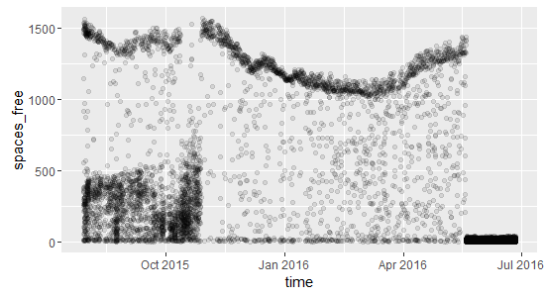
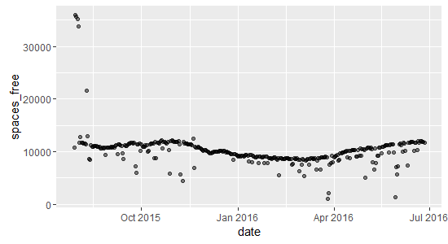
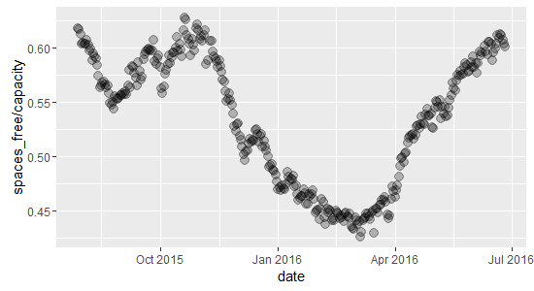
Bike Use Data Exploration
1: Mess
2: Ok Pattern
3: Solid Pattern
1: Data in time is messy: there’s a pattern, but data don’t align well
And in recent months, very irregular data
2: Looking at “daily use” means gives some pattern! But lots of outliers!
3: Looking at % shows a pattern: total spaces free / total station size
But daily aggregates lose time information…and bike use is expected to correlate with times of the day…

Slide 3
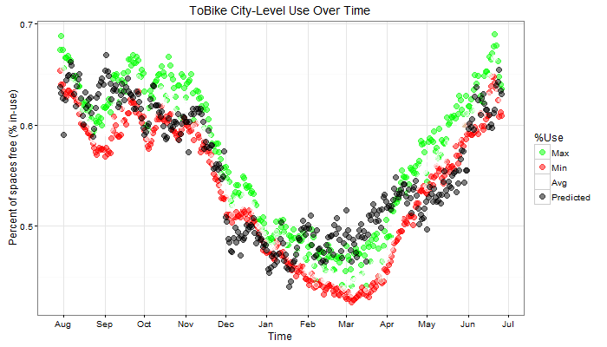
Time and Use Pattern!
Time “Windows” were passed over the data, collecting all stations reporting in the window period and thus a view of all bikes in/out at that 20-minute interval
Usage is highly seasonal and weather dependent
Model has 0.78 R^2 value, plotted in black (right)
“Use” fluctuations between 45% and 70% free bike stations over the year

Slide 4
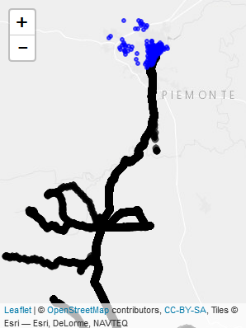
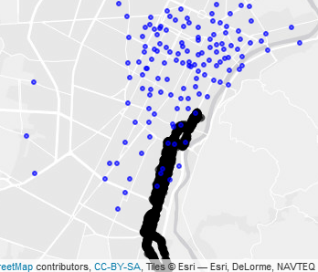
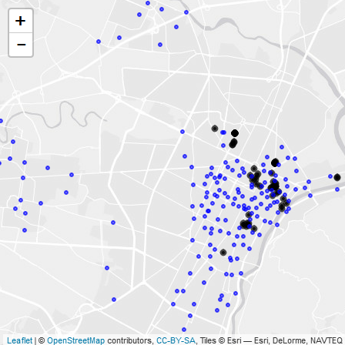
Air Quality: Dropped due to data unavailability
Shows a guy driving around on a mobile sensor along river and then into mountains
Noise: Dropped due to data unavailability
Sensors concentrated in areas of the city and no reason why noise in one part of city would affect bike use in another part
Attempted to look at overall city-level noise (eg, noise spikes on New Year and also spikes biked use?). But data collection too infrequent

Slide 5
Model Theory
System city-level use
We have good estimates of city-level use for a given day…
2. Assume: each individual station use correlates with overall city-level use. On a high-use day, popular stations will see maximum use; and even unpopular stations will see above-average use….And on low-use days when it’s snowing and cold, all stations may expect below average use.
3. Comparing city-level “spaces free” with our 431,105 timeseries station-level data “spaces free” and model station use compared to city-use and how nearby features (hospitals, busses, markets) impact above-average and below-average comparisons; while also controlling for weather and seasonal patterns by incorporating results of city-level model output
4. Our goal is to determinate which features matters in the probability that a given station will be an “high-used” station or not.

Slide 6
Model Results
Macro Model: toBike Use in Turin
Micro Model: probability to be a “high used” station
 | Estimate | Std. Error | t value | Pr(>|t|)
(Intercept) | 0.555358 | 0.003008 | 184.6 | < 2e-16 | ***
Mean.TemperatureC | 0.003718 | 0.000272 | 13.652 | < 2e-16 | ***
CloudCover | -0.00229 | 0.000363 | -6.307 | 3.29E-10 | ***
MeanDew.PointC | 0.00178 | 0.000238 | 7.468 | 1.08E-13 | ***
tstormTRUE | 0.008972 | 0.002006 | 4.472 | 8.07E-06 | ***
isWeekendTRUE | -0.00549 | 0.001367 | -4.015 | 6.11E-05 | ***
seasonspring | -0.07673 | 0.001846 | -41.567 | < 2e-16 | ***
seasonsummer | -0.03031 | 0.002374 | -12.768 | < 2e-16 | ***
seasonwinter | -0.07836 | 0.002214 | -35.388 | < 2e-16 | ***
precipTRUE | -0.00702 | 0.001668 | -4.209 | 2.65E-05 | ***
---
Signif. codes: 0 ‘***’ 0.001 ‘**’ 0.01 ‘*’ 0.05 ‘.’ 0.1 ‘ ’ 1
Residual standard error: 0.03222 on 2776 degrees of freedom
Multiple R-squared: 0.7844, Adjusted R-squared: 0.7837
F-statistic: 1122 on 9 and 2776 DF, p-value: < 2.2e-16
 | Estimate |  | Std. Error | z value | Pr(>|z|)
(Intercept) | 2,08E+03 |  | 1,07E+03 | 1.947 | 0.05155 .
Total_population | -4,71E-02 |  | 2,33E-02 | -2.025 | 0.04282 *
perc_stranieri | -5,08E+03 |  | 2,67E+03 | -1.907 | 0.05647 .
bus_stops | -4,53E+01 |  | 2,48E+01 | -1.829 | 0.06737 .
average_dist_bus | 4,06E+00 |  | 4,17E+00 | 0.973 | 0.33035
num_schools | 1,56E+01 |  | 4,53E+01 | 0.344 | 0.73081
average_dist_school | -2,01E+00 |  | 1,18E+00 | -1.698 | 0.08953 .
num_mall | -1,43E+03 |  | 1,26E+03 | -1.134 | 0.25696
average_dist_mall | 7,77E+00 |  | 7,25E+00 | 1.072 | 0.28391
num_open_air_market | -1,97E+03 |  | 4,58E+02 | -4.303 | 1.69e-05 ***
average_dist_open_air_market | 1,09E+01 |  | 2,52E+00 | 4.308 | 1.65e-05 ***
num_sale | 1,08E+02 |  | 3,67E+01 | 2.930 | 0.00339 **
average_dist_sale | -3,82E+00 |  | 1,49E+00 | -2.558 | 0.01051 *
num_hosp | -1,64E+04 |  | 1,19E+04 | -1.386 | 0.16567
average_dist_hosp | 5,12E+01 |  | 3,60E+01 | 1.422 | 0.15509
average_dist_hosp | 5,12E+01 |  | 3,60E+01 | 1.422 | 0.15509
Signif. codes: 0 ‘***’ 0.001 ‘**’ 0.01 ‘*’ 0.05 ‘.’ 0.1 ‘ ’ 1
roc.formula(formula = use ~ prob)
Data: prob in 153 controls (use 0) < 305 cases (use 1).
Area under the curve: 0.7632

Slide 7
High-Low Use Stations
More than 50% of the stations are high use…Which means that the stations below the probability mean are really, really not used compared to their more popular neighbors
The features that influence the probability to be over the “average use” seems to be features that identify the city center zone
Urban life correlate with higher bike use
Placeholder to add high low use stations

Slide 8
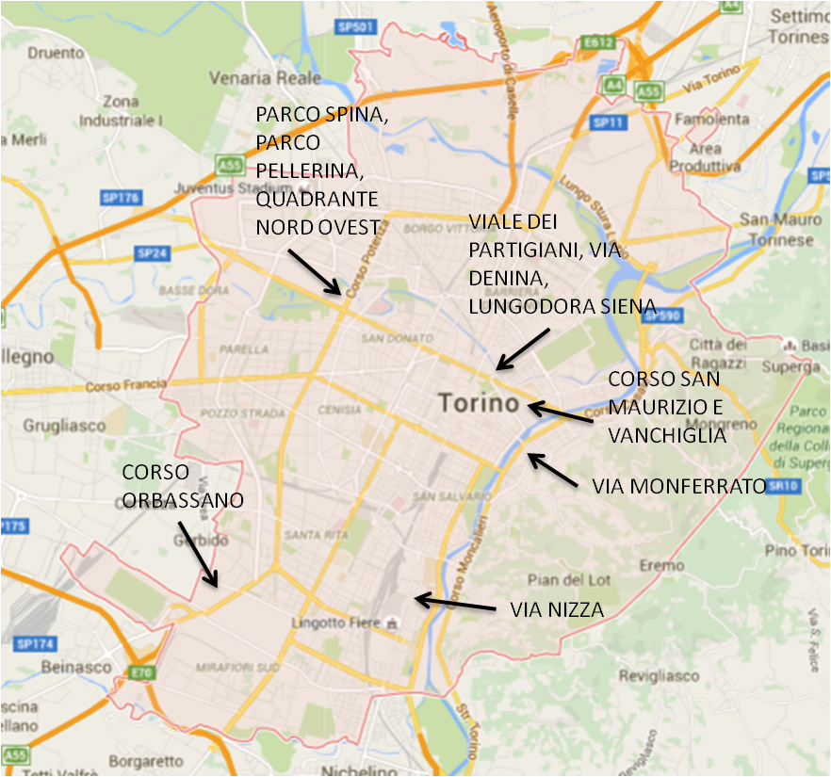
CONCLUSIONS
You asked Where!?
Here!
#1 new station placement is “Corso San Maurizio E Vanchiglia” (83% probability to be a “high use” station)
Of the 6 proposed station locations, 4 are predicted to have “above average” usage compared to current ToBike expectations
Only 1,2 and 3 have reasonable probability to be “above average”
4, 5, 6 are at approximately average or below
4
5
1
6
2
3

